Slide 1

Traffic Accident Severity Prediction
Abhijit Kumar Dutta

Slide 2
Background
WHO research says 1.35 million road traffic deaths in 2016 with millions others suffering from severes injuries.
Globally, traffic crashes are a leading cause of death among young people aged 15-27 years.
Road traffic injuries are currently estimated to be the eighth leading cause of death across all age groups globally.
Several factors contribute to the accidents. Few mentionable factors are weather conditions, road conditions and lighting, locatity and time of commute , type of vehicle etc.

Slide 3
Introduction
The project aims to forecast the severity of accidents with previous information
Data that might contribute to determining the likeliness of a potential accident occurring might include information on previous accidents such as road conditions, weather conditions, exact time and place of the accident, type of vehicles involved in the accident, information on the users involved in the accident and the severity of the accident.Road traffic injuries are currently estimated to be the eighth leading cause of death across all age groups globally.
Governments should be highly interested in accurate predictions of the severity of an accident, in order to reduce the response time of the emergency medical services and to make a more efficient use of the resources.
The prediction will also help private companies investing in technologies aiming to improve road safety procedures.

Slide 4
Data Acuisition and Cleaning
Users, Places, Charateristics, vehicles and holidays data from kaggle dataset
https://www.kaggle.com/ahmedlahlou/accidents-in-france-from-2005-to-2016
5 datasets were used consisting of all the recorded accidents in France from 2005-2016.
1. Characteristics Dataset : Time, Place, Collision type, weather and lighting conditions.,etc
2. Places Dataset : Road gradient, shape, category, surface condition and infrastructure,etc
3. User Dataset : Place, user infomation, reason for travel, severity of accident, etc.
4. Vehicle Data : Vehicle type
5. Holiday : Labels the accident occuring on a holiday.
Redundant and non relevant features are dropped, feature engineering is performed on the data set and finally 29 features are selected for model building.
Feature seection notebook link :
https://github.com/abhijitcse414/Applied-Data-Science-Capstone/blob/master/Feature%20Selection.ipynb

Slide 5
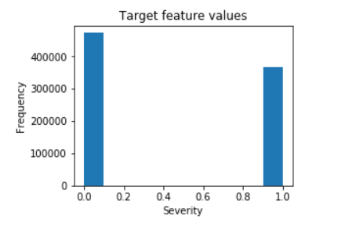
Exploratory Data Analysis- Target
The target feature is a binary classifier depicting accident severity.
0 - Low severity
1 - High Severity i.e. hospitalized, wounder injuries to death.
balanced label dataset with more low severity accidents.

Slide 6
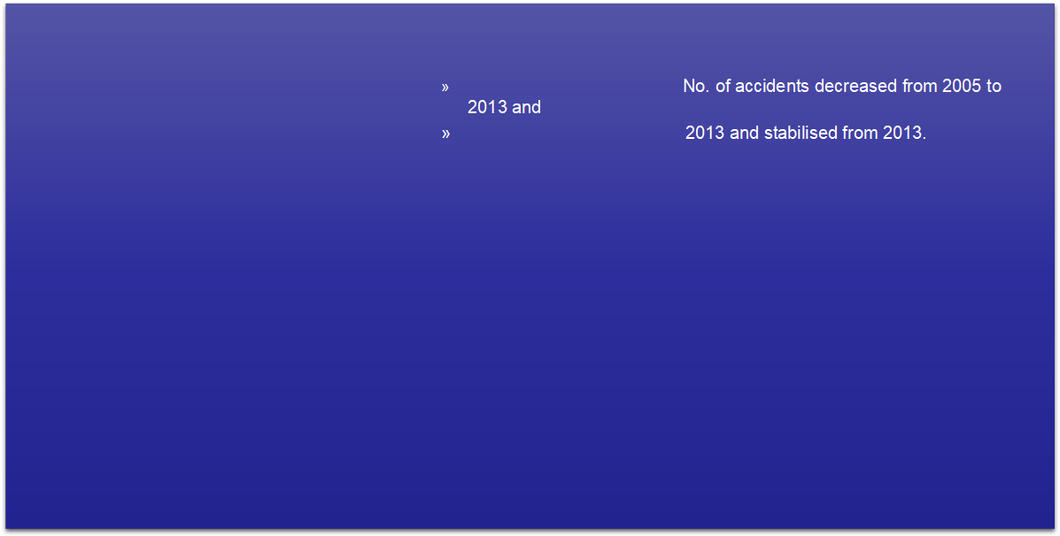
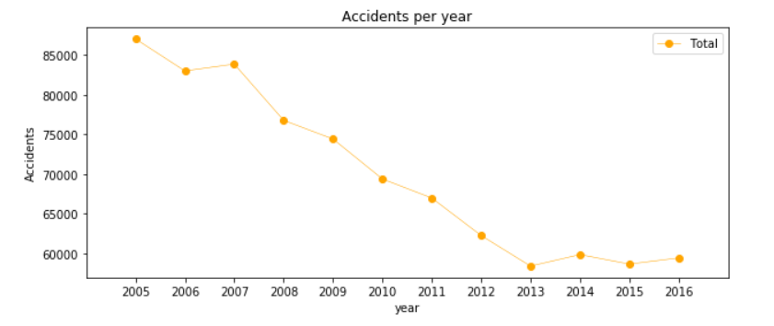
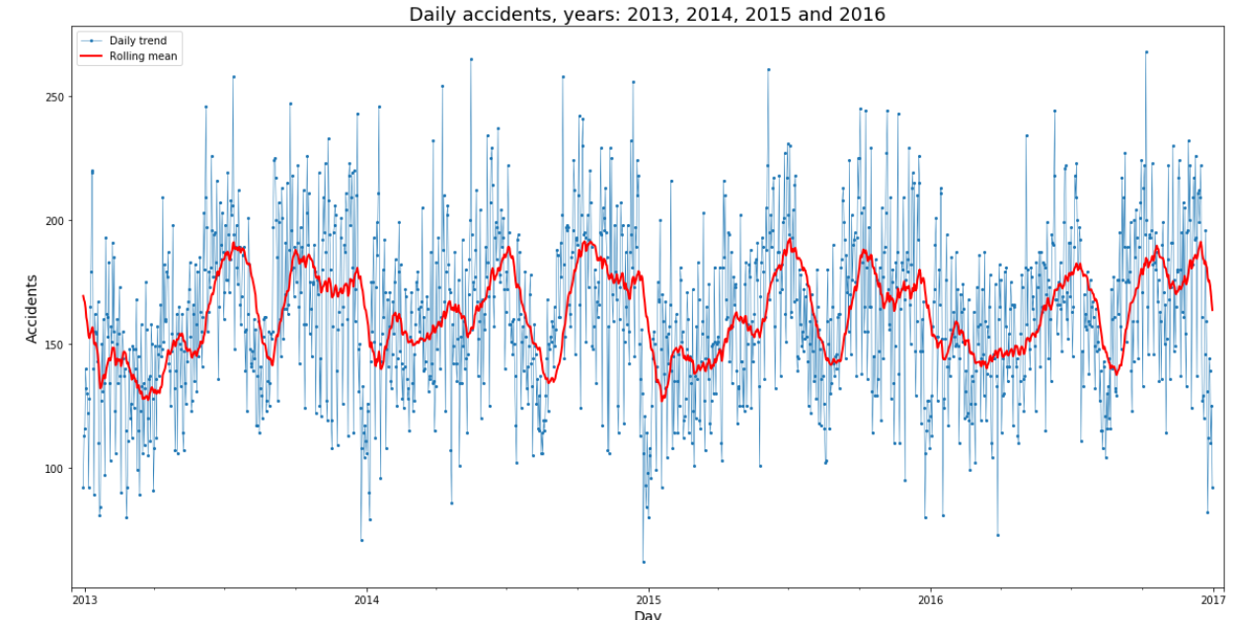
Exploratory Data Analysis- Seasonality

Slide 7
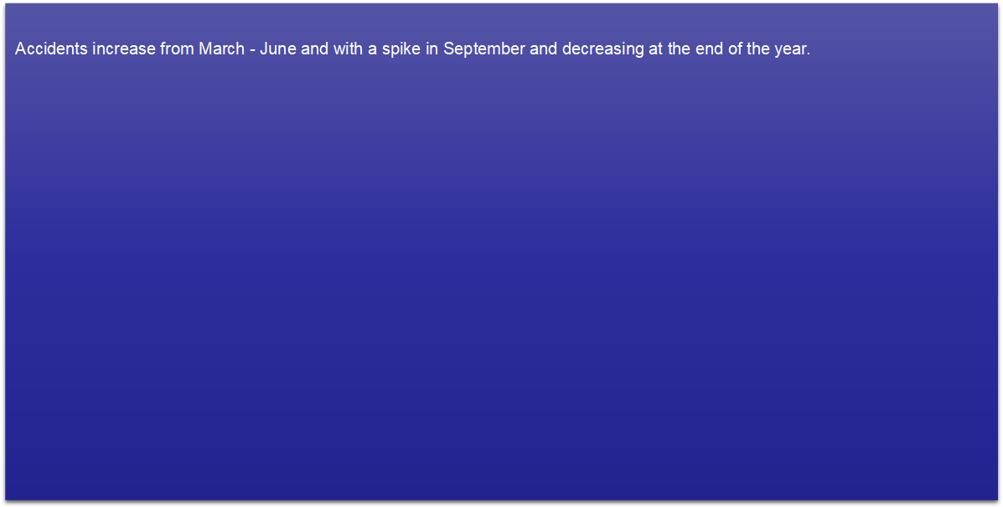
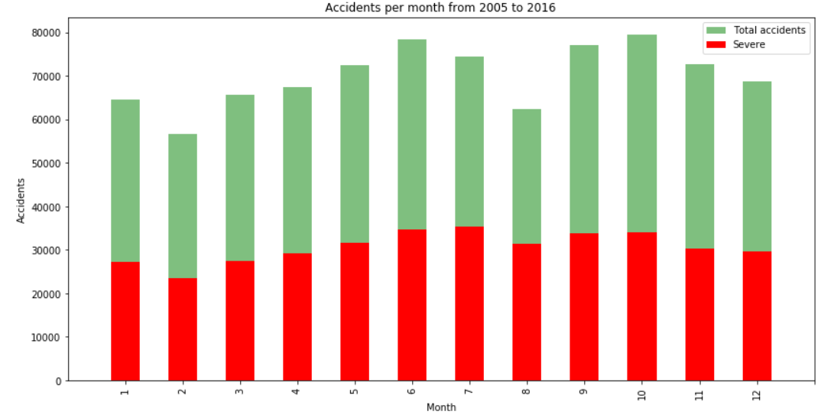
Exploratory Data Analysis- Seasonality

Slide 8
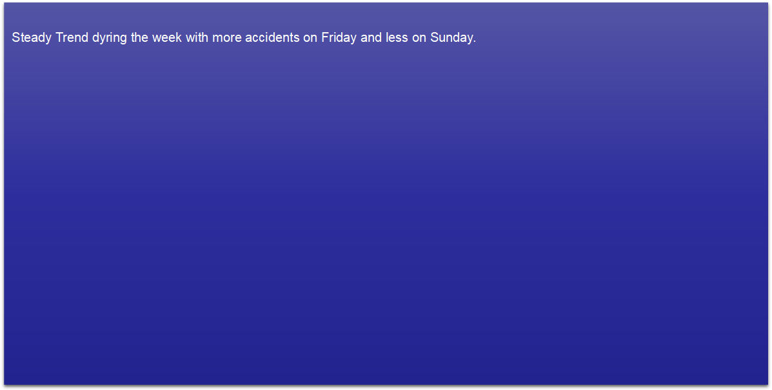
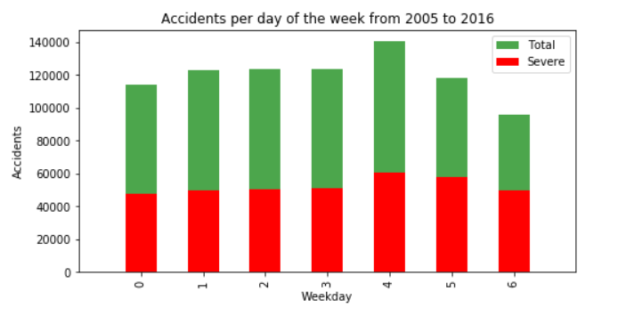
Exploratory Data Analysis- Seasonality

Slide 9
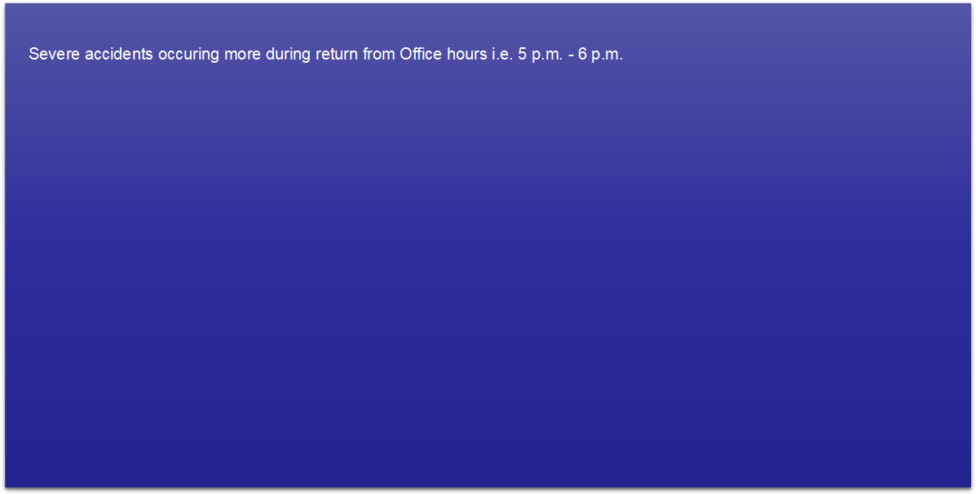
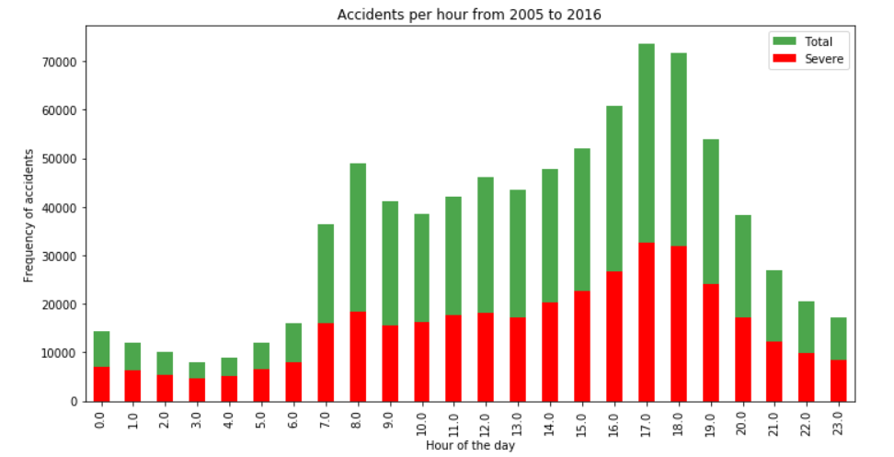
Exploratory Data Analysis- Seasonality

Slide 10
Model Building
Four Classification Models used for Model Building
Random Forest Logistic regression
10 Decision tress C = 0.001
Max depth - 12
K Nearest Neighbor Support Vector Machines
K = 16 Training samples reduced to 75,000.

Slide 11
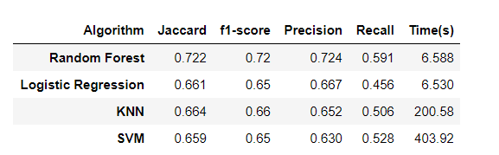
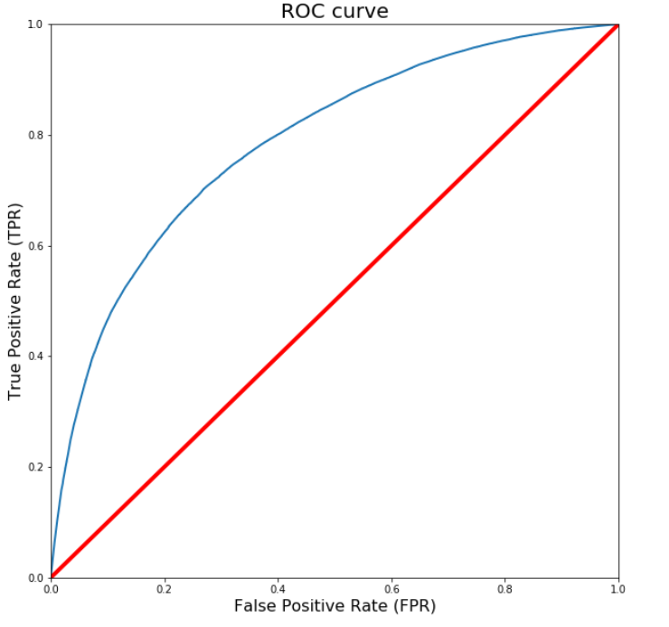
Results
Evaluation results of the Models.
Random Forest is the best model with
Accuracy - 0.72 and Recall - 0.59

Slide 12
Conclusion and Future Direction
Built useful models to predict whether and how much a player will improve.
Accuracy of the models has room for improvement.
Future Projects :
1. Add features such as vehicle and time of uninterrupted travelling.
2. Prediction of potential accident,critical spots and time.

